Slide 1
gitflow
Professioneel een website ontwerpen

Slide 2


Opzetten team
Werk in teams van 2 of 3 studenten
Student 1
Student 2
Student 3

Slide 3

Fork the template
Student 1
https://github.com/djsjollema/webflow

Slide 4
Clone the template
Student 1

Slide 5

Create new branch develop and checkout
Student 1
develop
main

Slide 6


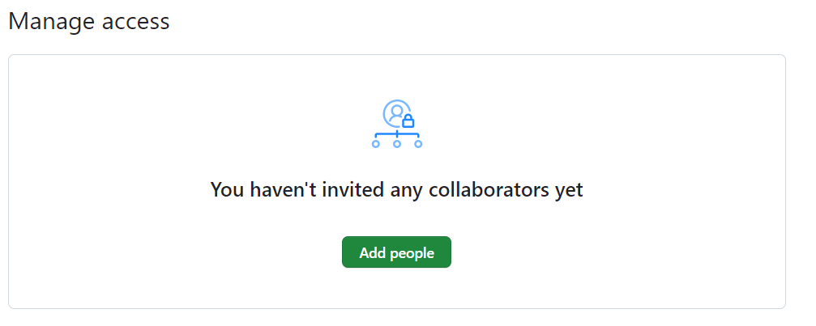
Nodig Student 2, 3 uit als collaborators
Student 1
Student 2
Student 3

Slide 7
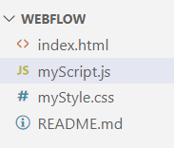
Maak de bestanden index.html, myStyle.css en myScript.js aan
Student 1
Accepteer de invitation for collaboration
Student 2
Student 3

Slide 8
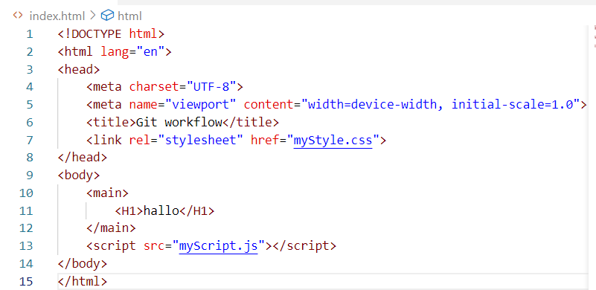
Edit index.html
Student 1

Slide 9
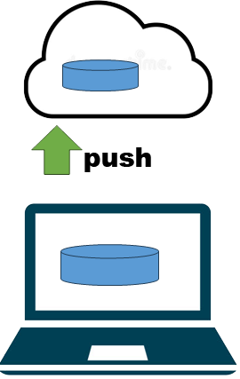
Add, commit and push it
Student 1

Slide 10
Accepteer invitation collaboration en CLONE
Student 2
Student 3
clone

Slide 11
Create branch feature/css and checkout
Student 2
feature/css
develop
main

Slide 12
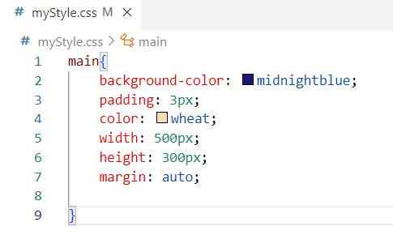
Edit myStyle.css
Student 2

Slide 13
Add, commit and push it
Student 2

Slide 14
Create branch feature/js and checkout
Student 3
feature/js
feature/css
develop
main

Slide 15
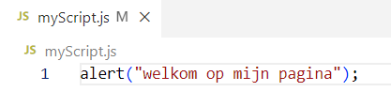
Edit myStyle.css
Student 3

Slide 16
Add, commit and push it
Student 3

Slide 17
Pull
Student 1
pull

Slide 18
Checkout develop
Student 3
feature/js
feature/css
develop
main

Slide 19
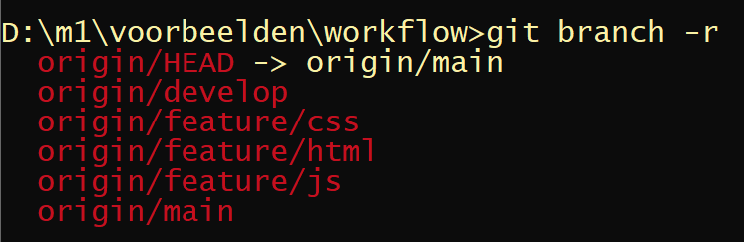
Controleer met branch –r of alle branches klaar staan
Student 1

Slide 20
Merge feature/cs
Student 3
feature/js
feature/css
develop
main

Slide 21
Merge feature/js
Student 3
feature/js
feature/css
develop
main

Slide 22
Add, commit and push it
Student 1

Slide 23
Pull
Student 2
Student 3
pull

Slide 24

Student 2 edit index.html
Student 2 edit myStyle.css Student 3 edit myScript.js
Student 1
Student 3
Student 2
feature/js
feature/js
feature/css
feature/css
Student 3
Student 2
develop
develop
Student 1
main

Slide 25
Als iedereen klaar is, pusht iedereen zijn of haar branch
Student 1
Student 2
Student 3

Slide 26
Controleer met branch –r of alle branches klaar staan, of dat er branches bijgekomen zijn
Student 1

Slide 27
Merge alles naar develop
Student 1
feature/js
feature/css
develop
main

Slide 28
Merge het eindproduct naar de branch main
Student 1
feature/js
feature/css
develop
main

Slide 29
Iedereen pullt het eindproduct
Student 2
Student 3

Slide 30

Klaar!

